Slide 1
MATHEMATICS ASSESMENT
COURSE
Multivariable Calculus and Differential Equations
Mathematical Modelling of Nutrient Uptake in Cells
SUBMITTED BY
Name: NAKUL SHRIVASTAVA
REGISTER NO.
26BCB0099
How Cell Shape and Surface Area Affect Nutrient Uptake
A well-mixed membrane model using differential equations, geometry and Octave
Notes:
Based on the original Cell Shape Diffusion Project presentation and the supplied BAMAT101 syllabus. The revised model assumes passive membrane entry, rapid internal mixing and no consumption. P is illustrative. This is an ODE model of average concentration, not a spatial diffusion PDE.

Slide 2

01 INTRODUCTION
Introduction and Problem Statement
Our Model: Nutrient Entry and Mixing
Objective
In this project, we model passive entry of nutrients through the membrane and assume that incoming nutrient mixes quickly throughout the cell
if we assume the concentration is uniform throughout the cell, then it does not vary with position (x):
But concentration can still change with time, so (dC/dt) can be nonzero. That is why our model uses C(t) instead of C(x,t)
This gives one average internal concentration C(t), rather than a different concentration at every position.
A long, thin cell can have the same volume as a round cell but a larger surface area. Does this extra surface allow its internal nutrient concentration to rise more quickly? We compare a root-hair-like cylinder with an equal-volume sphere, keeping membrane permeability and the outside concentration the same.
To build a nutrient balance, solve for the average internal concentration, and compare the time needed for each cell shape to reach 90% of the outside concentration.
Assumptions
Same membrane permeability (hence a larger surface-area-to-volume ratio gives faster uptake)
Equal volume ( hence, the long, thin cylinder should reach a chosen concentration sooner than the sphere)
2
Notes:
Based on the original Cell Shape Diffusion Project presentation and the supplied BAMAT101 syllabus. The revised model assumes passive membrane entry, rapid internal mixing and no consumption. P is illustrative. This is an ODE model of average concentration, not a spatial diffusion PDE.

Slide 3
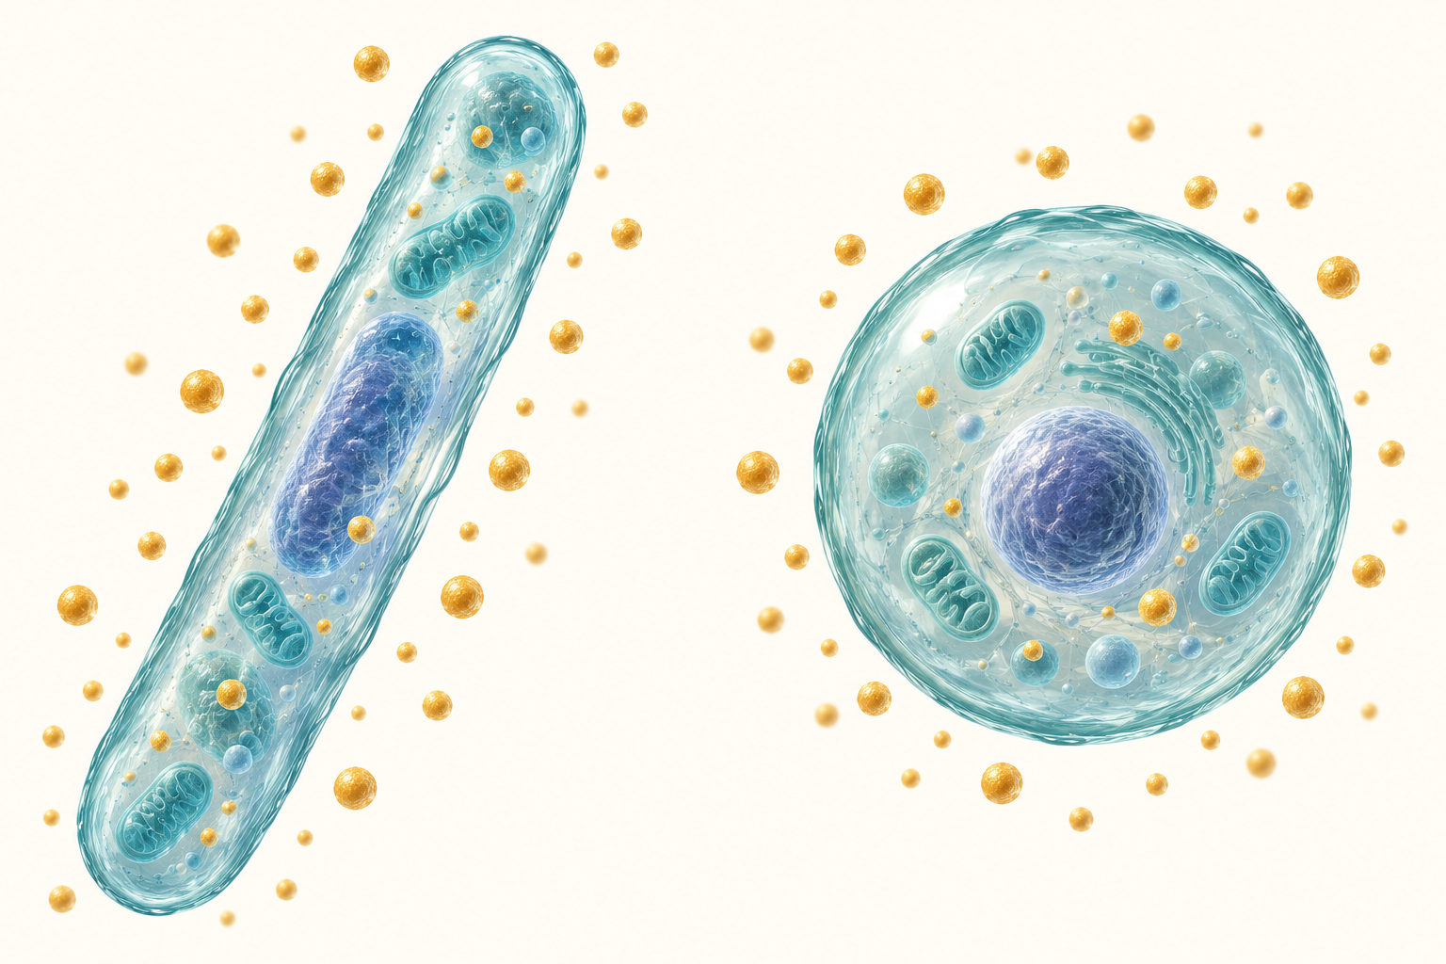
CELL SHAPE
The Same Volume, a Different Entry Surface
Surface area is the entry space
Nutrient crosses the membrane. More surface provides more entry area when the permeability and concentration difference are the same.
Why equal volume?
Comparing equal volumes isolates the effect of the surface area.
3
Notes:
Based on the original Cell Shape Diffusion Project presentation and the supplied BAMAT101 syllabus. The revised model assumes passive membrane entry, rapid internal mixing and no consumption. P is illustrative. This is an ODE model of average concentration, not a spatial diffusion PDE.

Slide 4
02 BACKGROUND
Linking the Mathematics to the Biology
Maths concept | What it means in the cell | Plays role in
Rate of change, dC/dt | How fast the average internal nutrient concentration rises as nutrient crosses the membrane. | Balance
Linear ODE with constant coefficients | C′′ + βC′ = 0 follows from the balance. Its exponential solution describes uptake over time. | Solution
Surface area S and volume V | The membrane provides the entry area. The cell volume determines how much nutrient is needed to raise concentration. | Geometry
Exponential decay, exp(−βt) | The concentration deficit Cout − C shrinks exponentially. Here β = PS/V is the uptake rate constant., appear in the solution of the ODE. | Graphs
Logarithms and time scales | τ = V/(PS) is the characteristic time. t90 = ln(10)τ gives a clear, finite comparison of uptake times. | Results
The ODE predicts average concentration, while cell geometry determines the uptake time scale.
4
Notes:
Based on the original Cell Shape Diffusion Project presentation and the supplied BAMAT101 syllabus. The revised model assumes passive membrane entry, rapid internal mixing and no consumption. P is illustrative. This is an ODE model of average concentration, not a spatial diffusion PDE.

Slide 5
03 METHODOLOGY
Flowchart of the Method
1
2
3
4
5
6
Ask the question
Build the model
Write the ODE
Solve it
Choose values
Compare uptake
Does a long, thin cell take up nutrients faster than an equal-volume sphere?
Assume a uniform inside concentration and passive entry(diffusion) across the surface.
Balance nutrient entry with accumulation: V C′ = PS(Cout − C).
Solve the constant-coefficient ODE to obtain C(t) and the time scale τ.
Use the original cell dimensions and one assumed permeability P.
Plot concentration and compare the times to reach 90% of Cout.
MATHS USED AT EACH STEP
Biological question
Surface area and volume
Rate of change
Linear ODEs
Substitution, units
Exponential and logarithm
Outcome: C(t) = Cout[1 − exp(−PS t/V)]. A larger S/V gives a shorter time to reach the same concentration.
5
Notes:
Based on the original Cell Shape Diffusion Project presentation and the supplied BAMAT101 syllabus. The revised model assumes passive membrane entry, rapid internal mixing and no consumption. P is illustrative. This is an ODE model of average concentration, not a spatial diffusion PDE.

Slide 6
CONSERVATION OF NUTRIENT
Why This Equation Describes Uptake
1. Amount inside = volume × concentration
For a fixed cell volume V, the amount inside is VC. Its rate of increase is V dC/dt.
2. Entry rate = area × permeability × concentration difference
Assume passive membrane flux J = P(Cout − C). Multiplying by the surface area S gives the total entry rate. P has units of length per time.
3. Accumulation equals entry when there is no consumption
V dC/dt = PS(Cout − C)
This model assumes a constant outside supply and fast mixing inside. Differentiating the balance gives C′′ + (PS/V)C′ = 0, a constant-coefficient ODE.
6
Notes:
Based on the original Cell Shape Diffusion Project presentation and the supplied BAMAT101 syllabus. The revised model assumes passive membrane entry, rapid internal mixing and no consumption. P is illustrative. This is an ODE model of average concentration, not a spatial diffusion PDE.

Slide 7
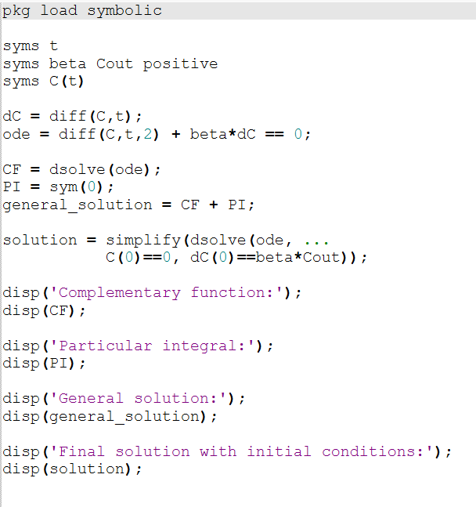
OCTAVE: SYMBOLIC SOLUTION
Using Octave to Solve the ODE
pkg load symbolic
syms t
syms beta Cout positive
syms C(t)
dC = diff(C,t);
ode = diff(C,t,2) + beta*dC == 0;
CF = dsolve(ode);
PI = sym(0);
general_solution = CF + PI;
solution = simplify(dsolve(ode, ...
C(0)==0, dC(0)==beta*Cout));
disp('Complementary function:');
disp(CF);
disp('Particular integral:');
disp(PI);
disp('General solution:');
disp(general_solution);
disp('Final solution with initial conditions:');
disp(solution);
9
Notes:
Official Octave symbolic documentation: https://octave.sourceforge.io/symbolic/function/@sym/dsolve.html . Requires a working symbolic package and its Python/SymPy dependencies. Installation can depend on the local Octave setup. Equivalent arrangements of the integration constants are valid. The full script prints headings and residual checks.
% Solve the uptake ODE symbolically, then plot the solver result.
% Requires the Octave symbolic package.
% If it is not installed, run once: pkg install -forge symbolic
clear; clc; close all;
pkg load symbolic
% PART 1: solve the second-order ODE
syms t
syms beta Cout positive
syms C(t)
dC = diff(C,t);
ode = diff(C,t,2) + beta*dC == 0;
CF = dsolve(ode);
PI = sym(0); % homogeneous equation: right-hand side is zero
general_solution = CF + PI;
solution = simplify(dsolve(ode, C(0)==0, dC(0)==beta*Cout));
disp('ODE:'); disp(ode);
disp('Complementary function:'); disp(CF);
disp('Particular integral:'); disp(PI);
disp('General solution = CF + PI:'); disp(general_solution);
disp('Solution after applying initial conditions:'); disp(solution);
% Verify both the ODE and the original nutrient balance
disp('ODE residual (expected 0):');
disp(simplify(diff(solution,t,2)+beta*diff(solution,t)));
disp('Balance residual (expected 0):');
disp(simplify(diff(solution,t)-beta*(Cout-solution)));
% PART 2: evaluate the result returned by dsolve
f = function_handle(solution,'vars',[t beta Cout]);
P = 1; % assumed permeability, micrometres/s
Cout_value = 1; % external concentration, arbitrary units
r = 6; L = 1000; % cylinder radius and length, micrometres
R = (3*r^2*L/4)^(1/3); % equal-volume sphere radius
q = [3/0.5, 2/r+2/L, 3/R];
beta_values = P*q;
time = linspace(0,30,601);
values = zeros(3,length(time));
for i = 1:3
values(i,:) = f(time,beta_values(i),Cout_value);
end
names = {'Small sphere','Thin cylinder','Equal-volume sphere'};
% PART 3: concentration versus time for the three shapes
figure(1);
plot(time,values(1,:)/Cout_value,'k-.', ...
time,values(2,:)/Cout_value,'b-', ...
time,values(3,:)/Cout_value,'r--','LineWidth',2);
xlabel('Time (seconds)');
ylabel('Internal / external concentration, C/Cout');
title('Concentration versus time for three cell shapes');
legend(names,'location','southeast');
ylim([0 1.05]); grid on;
% PART 4: time to reach 90 percent versus cell shape
tau = 1./beta_values;
t90 = log(10)*tau;
figure(2);
bar(t90);
set(gca,'xtick',1:3,'xticklabel',names);
ylabel('Time to reach 90 percent (seconds)');
title('90-percent uptake time versus cell shape');
grid on;
for i = 1:3
fprintf('%s: tau = %.3f s, t90 = %.3f s\n',names{i},tau(i),t90(i));
end
fprintf('Sphere/cylinder uptake-time ratio = %.3f\n',t90(3)/t90(2));
% Optional graph exports:
% print(1,'concentration_vs_time.png','-dpng','-r150');
% print(2,'uptake_time_vs_shape.png','-dpng','-r150');

Slide 8
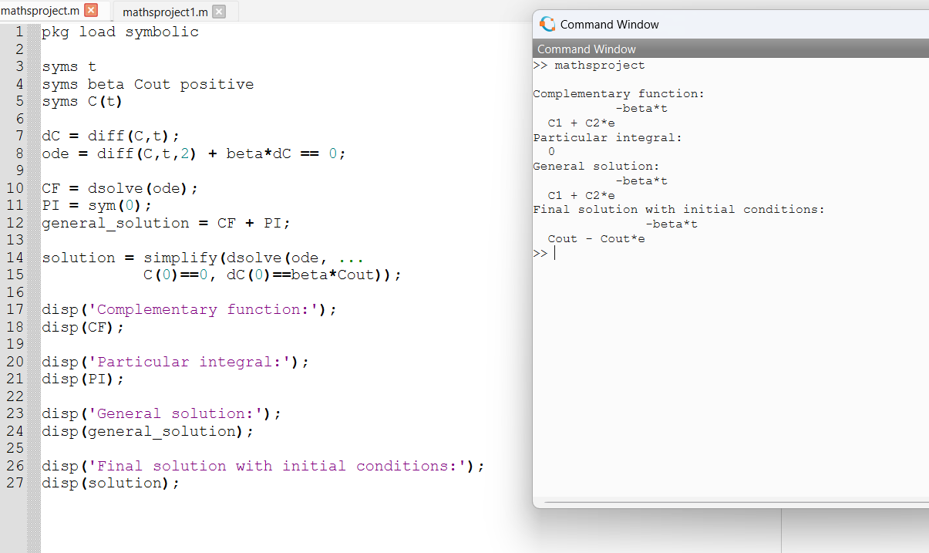
OCTAVE: SYMBOLIC SOLUTION
Octave output
9
Notes:
Official Octave symbolic documentation: https://octave.sourceforge.io/symbolic/function/@sym/dsolve.html . Requires a working symbolic package and its Python/SymPy dependencies. Installation can depend on the local Octave setup. Equivalent arrangements of the integration constants are valid. The full script prints headings and residual checks.
% Solve the uptake ODE symbolically, then plot the solver result.
% Requires the Octave symbolic package.
% If it is not installed, run once: pkg install -forge symbolic
clear; clc; close all;
pkg load symbolic
% PART 1: solve the second-order ODE
syms t
syms beta Cout positive
syms C(t)
dC = diff(C,t);
ode = diff(C,t,2) + beta*dC == 0;
CF = dsolve(ode);
PI = sym(0); % homogeneous equation: right-hand side is zero
general_solution = CF + PI;
solution = simplify(dsolve(ode, C(0)==0, dC(0)==beta*Cout));
disp('ODE:'); disp(ode);
disp('Complementary function:'); disp(CF);
disp('Particular integral:'); disp(PI);
disp('General solution = CF + PI:'); disp(general_solution);
disp('Solution after applying initial conditions:'); disp(solution);
% Verify both the ODE and the original nutrient balance
disp('ODE residual (expected 0):');
disp(simplify(diff(solution,t,2)+beta*diff(solution,t)));
disp('Balance residual (expected 0):');
disp(simplify(diff(solution,t)-beta*(Cout-solution)));
% PART 2: evaluate the result returned by dsolve
f = function_handle(solution,'vars',[t beta Cout]);
P = 1; % assumed permeability, micrometres/s
Cout_value = 1; % external concentration, arbitrary units
r = 6; L = 1000; % cylinder radius and length, micrometres
R = (3*r^2*L/4)^(1/3); % equal-volume sphere radius
q = [3/0.5, 2/r+2/L, 3/R];
beta_values = P*q;
time = linspace(0,30,601);
values = zeros(3,length(time));
for i = 1:3
values(i,:) = f(time,beta_values(i),Cout_value);
end
names = {'Small sphere','Thin cylinder','Equal-volume sphere'};
% PART 3: concentration versus time for the three shapes
figure(1);
plot(time,values(1,:)/Cout_value,'k-.', ...
time,values(2,:)/Cout_value,'b-', ...
time,values(3,:)/Cout_value,'r--','LineWidth',2);
xlabel('Time (seconds)');
ylabel('Internal / external concentration, C/Cout');
title('Concentration versus time for three cell shapes');
legend(names,'location','southeast');
ylim([0 1.05]); grid on;
% PART 4: time to reach 90 percent versus cell shape
tau = 1./beta_values;
t90 = log(10)*tau;
figure(2);
bar(t90);
set(gca,'xtick',1:3,'xticklabel',names);
ylabel('Time to reach 90 percent (seconds)');
title('90-percent uptake time versus cell shape');
grid on;
for i = 1:3
fprintf('%s: tau = %.3f s, t90 = %.3f s\n',names{i},tau(i),t90(i));
end
fprintf('Sphere/cylinder uptake-time ratio = %.3f\n',t90(3)/t90(2));
% Optional graph exports:
% print(1,'concentration_vs_time.png','-dpng','-r150');
% print(2,'uptake_time_vs_shape.png','-dpng','-r150');

Slide 9
MATHEMATICAL SOLUTION
The ODE, Complementary Function and Particular Integral
1. The ODE
C′′ + βC′ = 0, where β = PS/V > 0
2. Complementary function (C.F.)
Auxiliary equation: m² + βm = m(m + β) = 0
Roots: m = 0 and m = −β
C.F. = K₁ + K₂ exp(−βt)
3. Particular integral (P.I.)
The right-hand side is zero, so take P.I. = 0.
General solution = C.F. + P.I. = K₁ + K₂ exp(−βt)
7
Notes:
C.F. means complementary function, not common factor. The factorization m(m+beta)=0 supplies the roots. Because the second-order ODE is homogeneous, a particular integral can be chosen as zero. Do not confuse this P.I. with the final solution satisfying the initial conditions. The first-order balance C prime + beta C = beta Cout has a nonzero particular integral Cout, but this slide consistently solves the second-order form.

Slide 10
MATHEMATICAL SOLUTION
Applying the Initial Conditions
The nutrient balance supplies both initial conditions
C(0) = 0 and C′(0) = βCout
Initially the cell contains no nutrient. The entry rate then equals βCout.
C = K₁ + K₂ exp(−βt) gives K₁ + K₂ = 0
C′ = −βK₂ exp(−βt) gives −βK₂ = βCout
Therefore K₂ = −Cout and K₁ = Cout.
Final solution: C(t) = Cout[1 − exp(−βt)]
At t = 0, C = 0. As time increases, C approaches Cout.
8
Notes:
Differentiating the first-order balance introduces an extra integration constant. Retaining the initial slope from the original balance selects the physically consistent second-order solution. Beta=P*S/V is positive for the assumed cells.

Slide 11
OCTAVE AND RESULTS
The Solved Equation: Visible Results
The solver returns the same solution as our working on slides 7–8. Arbitrary constants may have different names in Octave.
Complementary function: K₁ + K₂ exp(−βt)
Particular integral: 0
General solution: K₁ + K₂ exp(−βt)
With the initial conditions: Cout[1 − exp(−βt)]
Check: C(0) = 0 and C′(0) = βCout. The initial slope is the rate at which concentration starts increasing.
10
Notes:
Mathematically evaluated expected symbolic result. This slide is not an Octave session screenshot. The arbitrary constants from dsolve may use different names.

Slide 12
OCTAVE AND RESULTS
What Do We Do with the Solved Equation?
We now know how the concentration inside a cell changes with time.
C(t) = Cout[1 − exp(−βt)] β = P × S/V
Cout is the outside concentration. C(t) is the inside concentration at time t. The number β describes how quickly the cell takes up nutrient.
For our comparison, permeability P and outside concentration stay the same. Each shape has a different surface-area-to-volume ratio, S/V.
Octave will use the same solution for each shape and compare the resulting uptake curves.
11
Notes:
Transition from the solver output on slide 10. The formula describes an initially empty, well-mixed cell with constant external supply and no nutrient consumption. A larger beta gives faster approach to the outside concentration. The same-volume comparison is between cylinder and large sphere only.

Slide 13
OCTAVE AND RESULTS
Choosing the Cell Shapes and Values
We use P = 1 µm/s and Cout = 1 concentration unit for all three shapes. These are demonstration values, not measurements.
Cell shape | Dimensions | S/V (µm⁻¹)
Small sphere | Radius = 0.5 µm | 6.0000
Long, thin cylinder | Radius = 6 µm; length = 1000 µm | 0.3353
Equal-volume sphere | Radius = 30 µm | 0.1000
The cylinder and the 30 µm sphere have the same volume. Their comparison isolates the effect of shape. The small sphere is an extra size comparison.
12
Notes:
The cylinder includes both end faces: S/V=2/r+2/L. A sphere has S/V=3/R. Equating pi*r^2*L to (4/3)*pi*R^3 gives R=(3*r^2*L/4)^(1/3)=30 micrometres. In the code q stores these S/V values. Only the cylinder and large sphere are equal-volume cells.

Slide 14
OCTAVE AND RESULTS
Small Sphere: Separate Calculation
Radius r = 0.5 µm; P = 1 µm/s.
S = 4πr² = 4π(0.5)² = 3.141593 µm²
V = (4/3)πr³ = (4/3)π(0.5)³ = 0.523599 µm³
S/V = 3/r = 3/0.5 = 6.000000 µm⁻¹
β = P(S/V) = 6.000000 s⁻¹ τ = 1/β = 0.166667 s
C(t)/Cout = 1 − exp(−6t)
t90 = ln(10)/6 = 0.383764 s
At 5 s: C/Cout ≈ 1.000000 (almost 100%). This small sphere is a size comparison, not an equal-volume comparison.
13
Notes:
All numerical results use the exact dimensions and unrounded beta. The displayed rounded beta is for reading only. Fixed external concentration and initially empty, well-mixed cell, no consumption. Time t is in seconds.

Slide 15
OCTAVE AND RESULTS
Thin Cylinder: Separate Calculation
Radius r = 6 µm and length L = 1000 µm; P = 1 µm/s.
S = 2πrL + 2πr² = 12072π = 37,925.307 µm²
V = πr²L = 36000π = 113,097.336 µm³
S/V = 2/r + 2/L = 0.335333 µm⁻¹
β = P(S/V) = 0.335333 s⁻¹ τ = 1/β = 2.982107 s
C(t)/Cout = 1 − exp(−0.335333…t)
t90 = ln(10)/β = 6.866556 s
At 5 s: C/Cout = 0.813004 (81.30%). Surface area includes the curved side and both circular ends.
14
Notes:
All numerical results use the exact dimensions and unrounded beta. The displayed rounded beta is for reading only. Fixed external concentration and initially empty, well-mixed cell, no consumption. Time t is in seconds.

Slide 16
OCTAVE AND RESULTS
Equal-Volume Sphere: Separate Calculation
R = (3r²L/4)^(1/3) = 30 µm, using the cylinder’s volume; P = 1 µm/s.
S = 4πR² = 3600π = 11,309.734 µm²
V = (4/3)πR³ = 36000π = 113,097.336 µm³
S/V = 3/R = 3/30 = 0.100000 µm⁻¹
β = P(S/V) = 0.100000 s⁻¹ τ = 1/β = 10.000000 s
C(t)/Cout = 1 − exp(−0.1t)
t90 = ln(10)/0.1 = 23.025851 s
At 5 s: C/Cout = 0.393469 (39.35%). It has the cylinder’s volume but less membrane area, so concentration rises more slowly.
15
Notes:
All numerical results use the exact dimensions and unrounded beta. The displayed rounded beta is for reading only. Fixed external concentration and initially empty, well-mixed cell, no consumption. Time t is in seconds.

Slide 17
OCTAVE AND RESULTS
Numerical Output: Concentration at Each Time
Each entry is C/Cout. For example, 0.813004 means 81.3004% of the outside concentration. With Cout = 1, these are also the C(t) values.
Time (s) | Small sphere | Thin cylinder | Large sphere
0 | 0.000000 | 0.000000 | 0.000000
0.1 | 0.451188 | 0.032977 | 0.009950
0.5 | 0.950213 | 0.154364 | 0.048771
1 | 0.997521 | 0.284900 | 0.095163
5 | 1.000000 | 0.813004 | 0.393469
10 | 1.000000 | 0.965032 | 0.632121
30 | 1.000000 | 0.999957 | 0.950213
At 5 seconds: small sphere ≈ 100%, cylinder = 81.30%, large sphere = 39.35%. A displayed 1.000000 is rounded, not exact equality.
16
Notes:
Values calculated directly from the solved equation using full-precision beta. Expected numerical values for the supplied Octave code, not an executed command-window capture.

Slide 18
OCTAVE AND RESULTS
Reading Graph 1: Which Cell Takes Up Faster?
Compare at the same time
At 5 seconds, the thin cylinder has reached 81.3% of the outside concentration. The equal-volume sphere has reached 39.3%. The cylinder’s curve rises sooner because it has more surface area per unit volume. The small sphere approaches the outside concentration even sooner.
Why do the curves flatten?
As the inside concentration rises, the difference between inside and outside becomes smaller. Nutrient entry slows, so every curve gradually levels off near C/Cout = 1.
17
Notes:
Prepared graph of the expected model curves, not a screenshot from an executed Octave run. Same chosen permeability for all three shapes. Only cylinder and large sphere have equal volume. The plot predicts average concentration and does not show concentration at the cell centre.

Slide 19
OCTAVE AND RESULTS
Graph 2: Time to Reach 90% of Cout
Time to reach C/Cout = 0.9 for each cell. A shorter bar means faster concentration rise under the same assumed permeability.
Equal-volume comparison: 23.026 ÷ 6.867 ≈ 3.35. The large sphere takes about 3.35 times as long as the cylinder.
18
Notes:
Native editable chart. Values = ln(10)/beta, calculated at full precision: [0.3837641821656743,6.866555943322205,23.025850929940457]. These are illustrative model predictions, not measured biological times. No Octave execution screenshot is implied.

Slide 20
OCTAVE AND RESULTS
What Do the Uptake Times Tell Us?
Idealized cell | S/V (µm⁻¹) | τ = V/(PS) | 90% time
Small sphere (radius 0.5 µm) | 6.0000 | 0.167 s | 0.384 s
Root-hair-like cylinder (r = 6 µm, L = 1000 µm) | 0.3353 | 2.982 s | 6.867 s
Equal-volume sphere (radius 30 µm) | 0.1000 | 10.000 s | 23.026 s
3.35×
3.35×
Why the cylinder is quicker
The cylinder and large sphere have equal volume. The cylinder has about 3.35 times more membrane area, so it reaches 90% in 6.87 s rather than 23.03 s. The small sphere reaches 90% in 0.384 s because its S/V ratio is much larger. These times assume the same P = 1 µm/s.
longer to reach 90% for the equal-volume sphere than for the thin cylinder
more surface per unit volume in the cylinder, including both end faces
19
Notes:
Based on the original Cell Shape Diffusion Project presentation and the supplied BAMAT101 syllabus. The revised model assumes passive membrane entry, rapid internal mixing and no consumption. P is illustrative. This is an ODE model of average concentration, not a spatial diffusion PDE.

Slide 21
OCTAVE AND RESULTS
Our Conclusion and What the Model Cannot Tell Us
What we found
What we assumed
What we can conclude
For cells with the same volume and permeability, shape affects the speed of nutrient uptake. Our thin cylinder has more membrane area, so its internal concentration rises faster. Octave makes this visible in the concentration curves and the time needed to reach 90%.
We assume nutrients mix quickly inside, the outside supply stays constant and permeability is uniform. We also leave out nutrient consumption. The shapes and permeability values are illustrative, so the calculated seconds are model predictions rather than measured biological times.
A larger surface-area-to-volume ratio gives faster average uptake under our assumptions. This does not prove that the sphere’s centre starves, because our model has no spatial variation. It also does not establish that one shape is best for every biological function.
20
Notes:
Based on the original Cell Shape Diffusion Project presentation and the supplied BAMAT101 syllabus. The revised model assumes passive membrane entry, rapid internal mixing and no consumption. P is illustrative. This is an ODE model of average concentration, not a spatial diffusion PDE.

Slide 22
REFERENCES
References and Declarations
References
[1] Linear second-order ODEs with constant coefficients, and surface and volume integrals.
[2] Provided BAMAT101Lab Manual (ODE calculations and plotting curves)
[
Declarations
Cell dimensions are illustrative geometries retained from the original project. Permeability P = 1 µm/s is an assumed value, not a measured biological parameter. Graphs evaluate the stated formula. AI assisted with explanations, code and conceptual artwork. The artwork is not anatomical evidence or drawn to scale.
21
Notes:
Based on the original Cell Shape Diffusion Project presentation and the supplied BAMAT101 syllabus. The revised model assumes passive membrane entry, rapid internal mixing and no consumption. P is illustrative. This is an ODE model of average concentration, not a spatial diffusion PDE.

